Slide 1
Research Presentation-2
Game data analytic using descriptive and predictive mining
By:- Priti Maurya

Slide 2
Index
1. About video game sales
2. Data
3. R language
4.Data Loading Process
5. Data Mining Techniques

Slide 3
Introduction
A video game is an electronic game that can be played on a computing device, such as a personal computer, gaming console or mobile phone.
Depending on the platform, video games can be subcategorized into computer games (for personal computer )and console games(need some remote or other device to play).
Example : console game gta5, spider man, Minecraft.
pc game (sonic, super mario)
In recent years however, the emergence of social networks, smartphones and tablets introduced new categories such as mobile and social games.
Video games have come a long way since the first games emerged in the 1970s.
Today's video games offer photorealistic graphics and simulate reality to a degree which is astonishing in many cases.

Slide 4
Overview of data study
The video game industry is the economic sector involved in the development, marketing, and monetization of video games.
It encompasses dozens of job disciplines and its component parts employ thousands of people worldwide.
The computer and video game industry has grown from focused markets to mainstream.
They took in about US$9.5 billion in the US in 2007, 11.7 billion in 2008, and 25.1 billion in 2010 (ESA annual report) and 159.3 billon in 2020 or 175.8 billion in 2021(currently counting) in pc market 37 billion and mobile marketing 77 billion in 2021 revenue report up april.
Modern personal computers owe many advancements and innovations to the game industry:
sound cards, graphics cards and 3D graphic accelerators, faster CPUs, and dedicated co-processors like PhysX(Nvidiabased api design) are a few of the more notable improvements.

Slide 5
analytical study of Video game industry and sales across the world
We study the given data set of sales of video games to find relations between different factors that affect video game sales. Our main objectives are :
- Finding which platform is more popular in which region and affects sale by how much
- Finding which year and period was more popular and how has it affected sales
- Finding which publisher is more popular in which region and affects sale by how much
- Finding which genre is more popular in which region and affects sale by how much
- How are the sales of America, Europe, Japan and other regions of the world correlated and is there a common pattern amongst all, or do they follow different trends
- Realizing and understanding the needs and trends in the video game industry to target the maximum customers in a new release of a game etc.

Slide 6
DATA
This dataset contains a list of video games with sales greater than 100,000 copies.
Fields include
Rank - Ranking of overall sales
Name - The games name
Platform - Platform of the games release (i.e. PC,PS4, etc.)
Year - Year of the game's release
Genre(Category) - Genre of the game

Slide 7
Publisher - Publisher of the game
NA_Sales - Sales in North America (in millions)
EU_Sales - Sales in Europe (in millions)
JP_Sales - Sales in Japan (in millions)
Other_Sales - Sales in the rest of the world (in millions)
Global_Sales - Total worldwide sales.

Slide 8
About language
R is a system for statistical computation and graphics. It provides, among other things, a programming language, high level graphics, interfaces to other languages and debugging facilities. This manual details and defines the R language.
The core of R is an interpreted computer language which allows branching and looping as well as modular programming using functions.
R allows integration with the procedures written in the C, C++, .Net or Python languages for efficiency.

Slide 9
R-pro and cons
Pro:
open source,
platform independent,
ML operations
Cons:
Weak origin(not support for dynamic or 3D graphics )
Data handling
Basic security

Slide 10
Data loading processing
# Loading the database
data <- read.csv("C:/Users/priya/Desktop/Game Research/gamedata/vgsales.csv", stringsAsFactors = FALSE)
# Removing the Rank column
data$Rank <- NULL
# Filtering only the records of interest for this study, removing the records with Year = NaN and records with the year above 2016
data <- data[data$Year != "N/A" & data$Year != "2017" & data$Year != "2020", ]
data$Year <- factor(data$Year)(factor = object data wich used as categorize the data and store is as level )
# Viewing the first 6 DataFrame records
head(data, 6) (head= display the 1st n of row present in data)
summary(data) (summary= is generic function producing a summary of the various data )

Slide 11
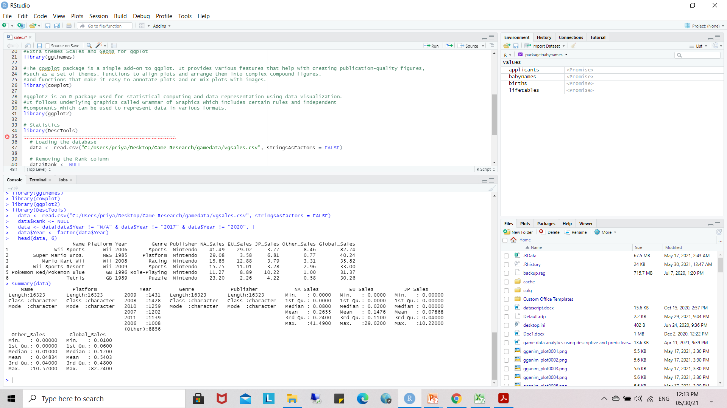
Output

Slide 12
Data Mining Techniques
Data mining
Predictive
Classification
Prediction
Descriptive
Association
Regression
Summarization
Clustering

Slide 13
Predictive
Classification : it Categorized the data in classes and work with structure and unstructured data process start with given predicting class from the given point.
Prediction: Prediction used a combination of other data mining techniques such as trends, clustering, classification, etc. It analyzes past events or instances in the right sequence to predict a future event.

Slide 14
Predictive
Regression : Regression analysis is the data mining process is used to identify and analyze the relationship between variables because of the presence of the other factor. It is used to define the probability of the specific variable. Regression, primarily a form of planning and modeling.

Slide 15
Descriptive
Association : Association rules are if-then statements that support to show the probability of interactions between data items within large data sets in different types of databases. Association rule mining has several applications and is commonly used to help sales correlations in data or video game data sets.
Clustering: we can say that Clustering analysis is a data mining technique to identify similar data. This technique helps to recognize the differences and similarities between the data. Clustering is very similar to the classification, but it involves grouping chunks of data together based on their similarities.

Slide 16
Descriptive
Summarization : Summarization is a key data mining concept which involves techniques for finding a compact description of a dataset. Simple summarization methods such as tabulating the mean and standard deviations are often applied for exploratory data analysis, data visualization and automated report generation.

Slide 17
Thank you

